Slide 1


Replace:
Name of your test
GreatProduct - Search
2020-xx-xx
Replace:
Key Visual for your test
(replace it on all slides)

Slide 2
GreatProduct - Search
Replace:
Name of your test session
Goal
  find Issues
  find usability problems
  …
  …
Name your session Goals

Slide 3
GreatProduct - Search
Replace:
Name of your test session
The Rules
  Everybody test on his own
  If you find something - shout ‘Bingo Bongo’
  Everyone stops working; the Finder shares his screen and presents the finding
  If everyone agrees the Finder has to fill an issue in the bugtracker and gets a point

Slide 4
GreatProduct - Search
Replace:
Name of your test session
Replace:
All the details to make sure everybody uses the correct software
We use DEV build 7.5.xx on Server ….
Maybe some installation/update instructiond
  and all the other details needed

Slide 5
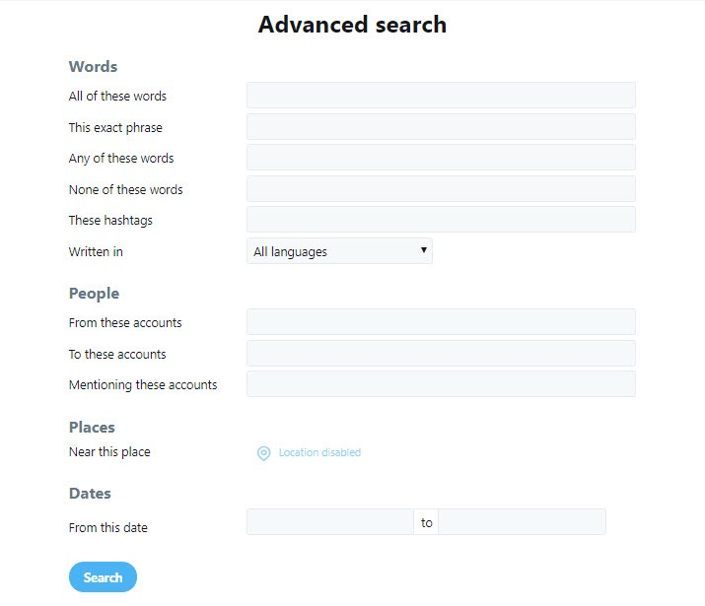
GreatProduct - Search
Replace:
Name of your test session
Specification
Demo
Point to the spec
or
Make a short presentation of the feature to test

Slide 6
GreatProduct - Search
Replace:
Name of your test session
If there are any
Known Issues
  ….
Main focus
  different ways to search
  Input verification
  User feedback
  Error messages
  …..
Replace:
Just to make the goal of the session clear again

Slide 7
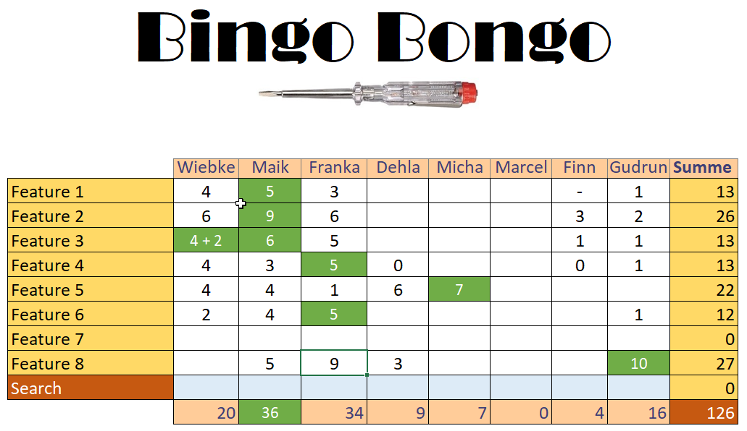
GreatProduct - Search
Replace:
Name of your test session
Have some table ready to count the points.
Use it for all sessions.

